Slide 1
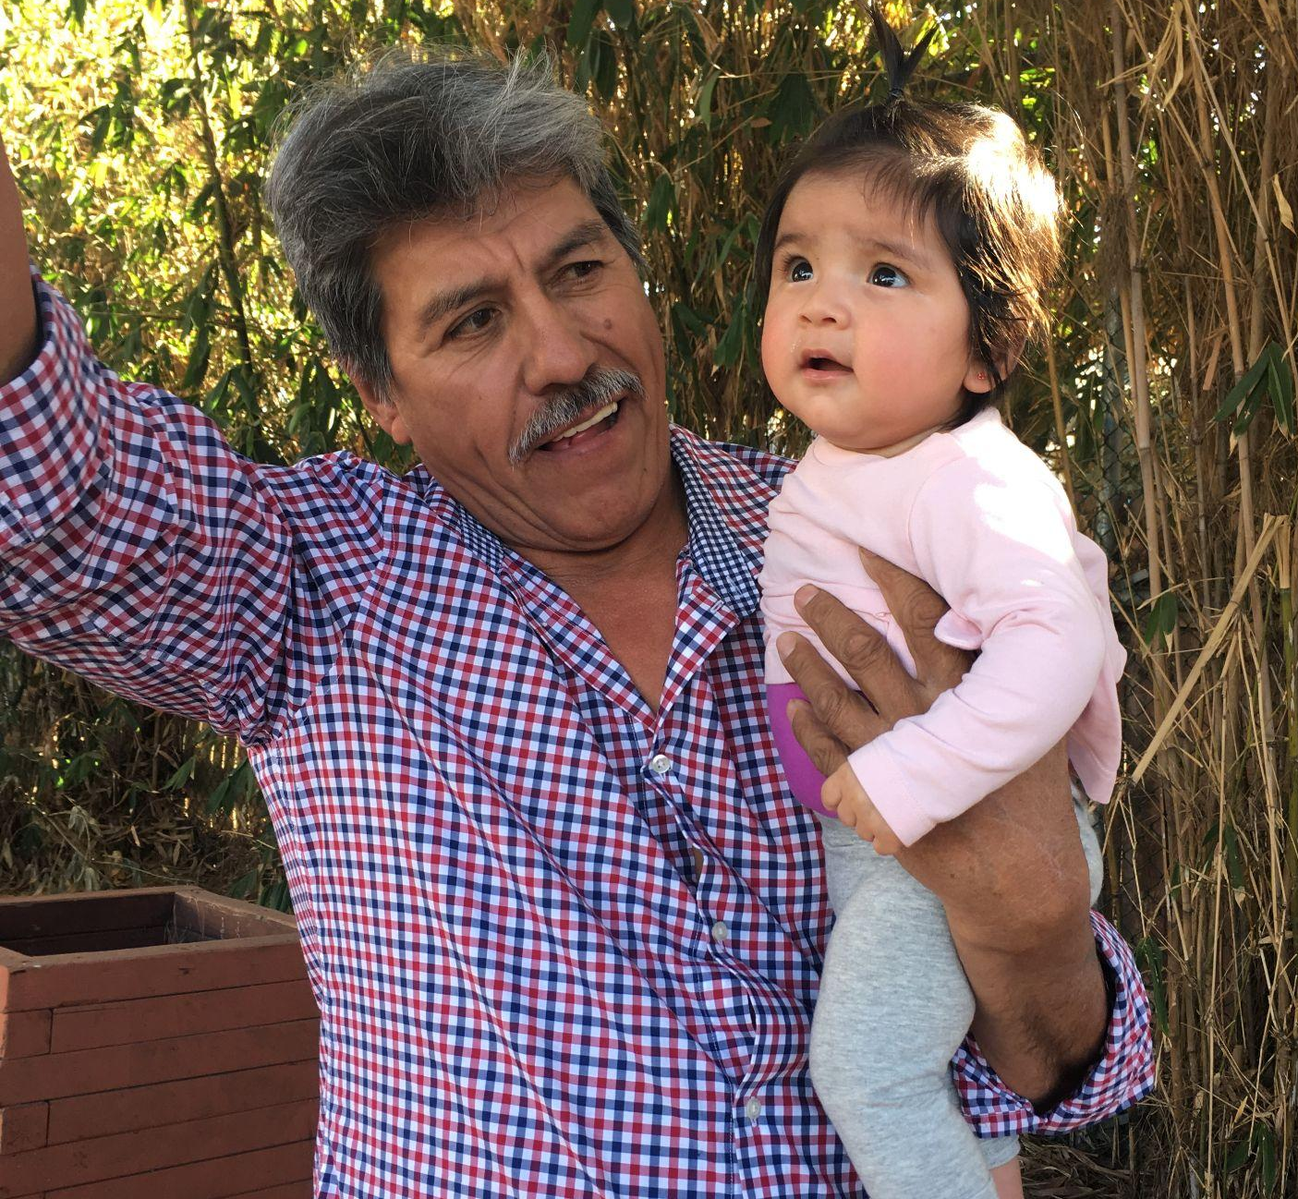
Best Start Región 1 Reunión Mensual
Lunes, 28 de march de 2022
5:00 pm - 7:30 pm
Jueves, 31 de marzo de 2022
9:00 am - 11:30 am
Best Start Region 1 Monthly Meeting
Monday, March 28th, 2022
5:00 pm - 7:30 pm
Thursday , March 31st, 2022
9:00 am - 11:30 am
Notes:
Ale D
Facilitadora | Facilitator Raymond
Notas | Notes

Slide 2
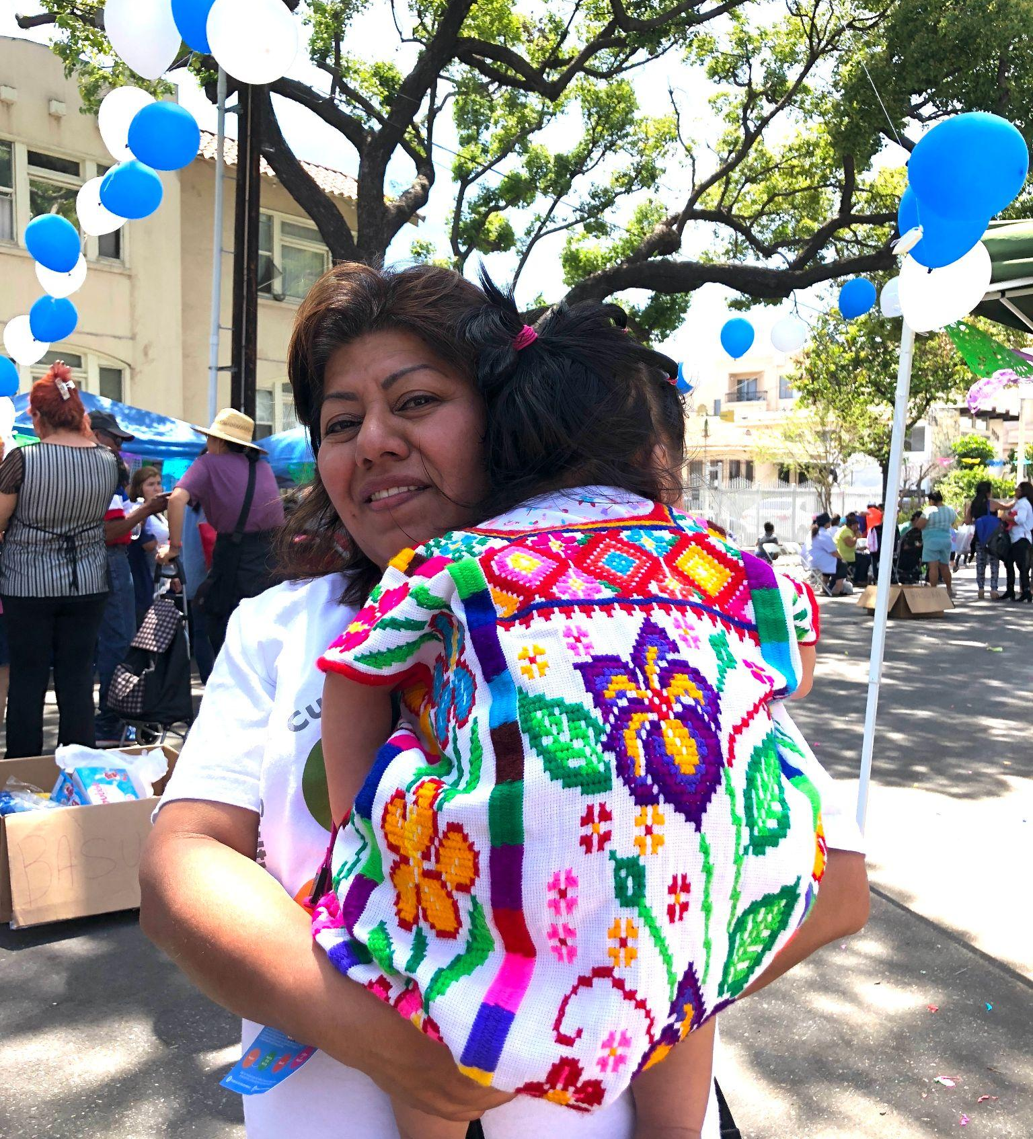
Bienvenida e Instalarse
Welcome & Get Settled
Notes:
Ale D
Facilitadora | Facilitator
Notas | Notes

Slide 3
Consejos
para Zoom
Zoom Tips
Notes:
Alejandra P.
Facilitadora | Facilitator
Notas | Notes

Slide 4
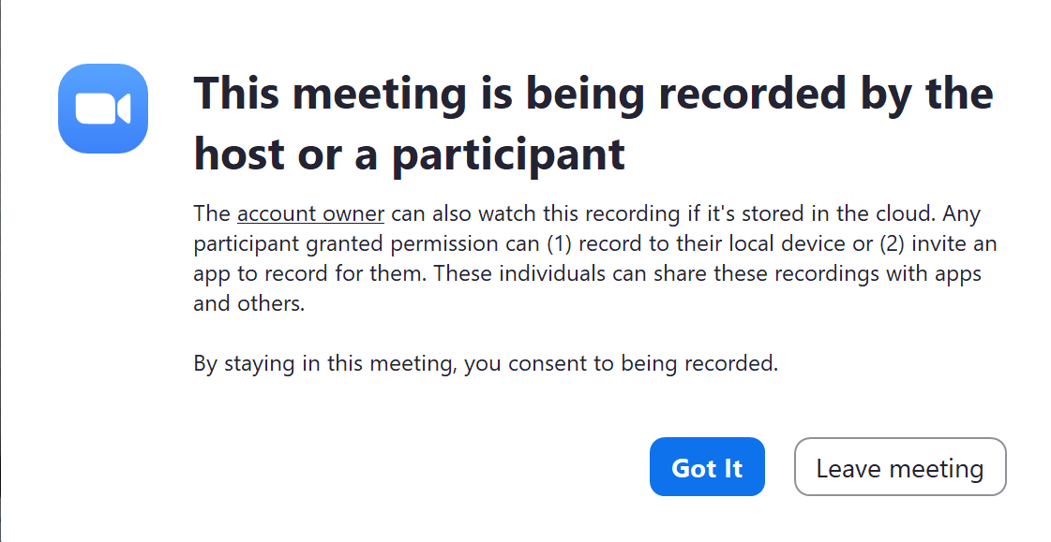
Grabación de la Reunión
Tenga en cuenta que la sesión de hoy se grabará (espacio grande), con la intención de publicarla en nuestro sitio web y en las páginas de las redes sociales para futuras referencias.
Tiene la opción de aceptar la grabación seleccionando "got it" (botón azul) o "leave meeting" (botón blanco) para rechazar la, lo que le retirara de la reunión.
Tenga en cuenta que cualquier cosa que comparta será visible/audible a través de la grabación.
Por favor, sea consciente de esto ya que puede influir en lo que decida y no comparta hoy.
Meeting Recording
Please be aware that today’s session will be recorded (large room), with the intention of posting it to our website and social media pages for future reference.
You have the option of acknowledging agreement to the recording by selecting “got it” (blue button) or “leave meeting” (white button) to decline which will remove you from the meeting.
Please be aware that anything you share will be viewable/audible through recording.
Please be mindful of this as it may influence what you decide and not share today.
Notes:
Alejandra P.
Facilitadora | Facilitator
Notas | Notes

Slide 5
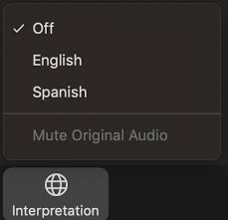
Interpretación
Si prefiere escuchar toda la presentación en español, por favor, presione el símbolo de “Interpretation” abajo de la pantalla de Zoom y luego elija “Spanish”
Si tiene problemas técnicos durante la reunión, por favor escriba en el chat
Tome descansos cuando necesite cuidarse a sí mismo o a su familia.
Interpretation
If you prefer to listen to the entire presentation in English, click on the Interpretation symbol at the bottom of the Zoom platform and then select English
If you experience technical issues during the meeting, please type in chat box
Take breaks when you need to take care of yourself or family.
Notes:
Alejandra P.
Facilitadora | Facilitator
Notas | Notes

Slide 6
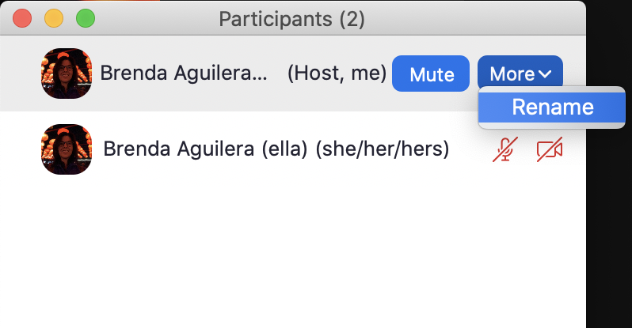
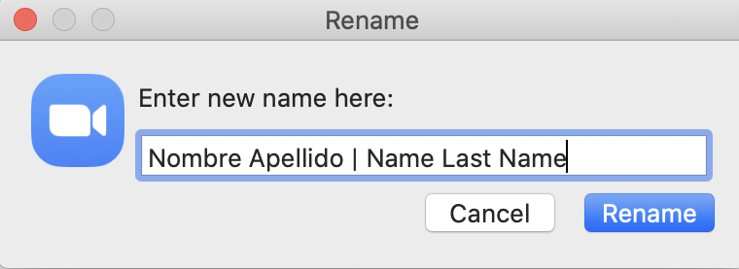
Visualice Su Nombre
Cambie su nombre:
Pasando la flecha sobre “Participants/Participantes”
Busca su cuenta y hace clic en “More/Más”
Haga clic en "Rename/Renombrar".
Añade su Nombre, Apellido y Comunidad de Best Start (Este LA, Metro LA, Sur El Monte/El Monte o Sureste LA)
Haga clic en “Rename/Renombrar”
2
3
Display Name
Rename yourself:
Hovering cursor over “Participants”
Identify your account and click on “More”
Click on “Rename”
Add you First Name, Last Name and Best Start Community (East LA, Metro LA, South El Monte/El Monte or Southeast LA)
Click on “Rename”
4
5
1
Notes:
Alejandra P.
Facilitadora | Facilitator
Notas | Notes

Slide 7
Interpretación
Interpretation
(Ingles)
(Español)
Notes:
Alejandra P.
Facilitadora | Facilitator
Notas | Notes

Slide 8
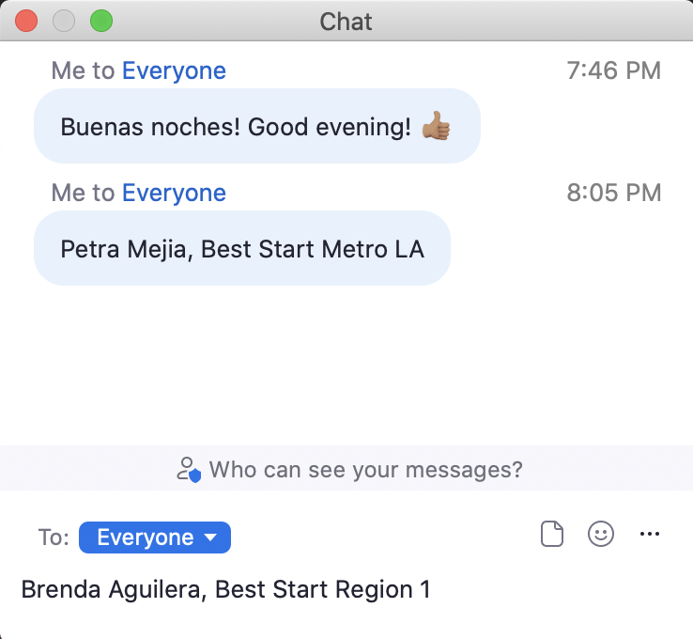
Interpretación
Interpretation
Caja de Chat para compartir comentarios o preguntas
Chat Box
to share comments or questions
(Ingles)
(Español)
Notes:
Alejandra P.
Facilitadora | Facilitator
Notas | Notes

Slide 9
Interpretación
Interpretation
Caja de Chat para compartir comentarios o preguntas
Chat Box
to share comments or questions
Control de Audio (por favor ponga su audio en silencio “Mute”)
Audio Control
(please Mute your mic)
(Ingles)
(Español)
Notes:
Alejandra P.
Facilitadora | Facilitator
Notas | Notes

Slide 10
Interpretación
Interpretation
Caja de Chat para compartir comentarios o preguntas
Chat Box
to share comments or questions
Control de Audio (por favor ponga su audio en silencio “Mute”)
Audio Control
(please Mute your mic)
(Ingles)
(Español)
Control de Video
Video Control
Notes:
Alejandra P.
Facilitadora | Facilitator
Notas | Notes

Slide 11
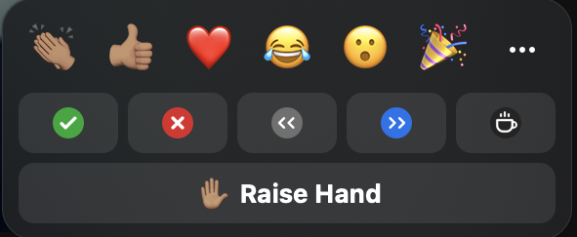
Interpretación
Interpretation
Caja de Chat para compartir comentarios o preguntas
Chat Box
to share comments or questions
Control de Audio (por favor ponga su audio en silencio “Mute”)
Audio Control
(please Mute your mic)
(Ingles)
(Español)
Control de Video
Video Control
Levantar la mano
para compartir
comentarios o preguntas
Raise hand
to share comments
or questions
Notes:
Alejandra P.
Facilitadora | Facilitator
Notas | Notes

Slide 12
Agenda
Agenda
Bienvenida 2 min
Consejos para Zoom 3 min
Agenda y Objetivos 3 min
Acuerdos Comunitarios 3 min
Rompehielo 15 min
Actualizaciones de esfuerzos 15 min
de Acción Colectiva a Nivel
Local y Regional
Descanso 5 min
LA Forward - Allison Henry 90 min
Evaluacion 2 min
Próximos Pasos 1 min
Cierre 1 min
Welcome 2 min
Zoom Tips 3 min
Agenda & Objectives 3 min
Group Agreements 3 min
Ice Breaker 15 min
Updates on Local and Regional Level 15 min
Collective Action Efforts
Break 5 min
LA Forward - Allison Henry 90 min
Evaluation 2 min
Next Steps 1 min
Closing 1 min
Notes:
Patty
Facilitadora | Facilitator
Questions (Reflect on Data, Conversations and Voting Process)
Data:
With all of data that was shared with you, which data point has stayed with you? Cual dato, la impresiona mas?
Conversations:
Did you go in there with an area of focus in mind, but then changed your mind?
If yes, what did you change your mind about and what helped you change your mind?
If no, why was this important for you?
Voting Process
What was your experience going through this voting process?
Visioning:
Now that you know that _______________________ is going to be the local focus area and ______________ is going to be the Regional focus area, what more do you want to know about this focus area?
What excites you about the potential to work on ________________ both locally and regionally?

Slide 13
Objetivos
Objectives
Alimentar y fortalecer nuestras relaciones.
Entender los próximos pasos en relación a nuestros esfuerzos de Abogacía Colectiva a Nivel Local y Regional.
Conocer los recursos relacionados con la inseguridad de la vivienda que son sensibles al tiempo
¡Celebrar nuestro último logro en nuestro plan de trabajo!
Nurture and strengthen our relationships.
Understand next steps on Local and Regional Collective Advocacy Efforts.
Become aware of time-sensitive resources related to housing insecurity
Celebrate our latest accomplishment in our work plan!
Notes:
Patty
Facilitadora | Facilitator
Notas | Notes

Slide 14
Acuerdos de Grupo
Group Agreements
Compartir el poder: Ser consciente de su privilegio (posicional, racial, étnico, lingüístico, de género, de orientación sexual, etc.) y dar un paso atrás para permitir que otros participen.
Celebrar la diversidad: buscar activamente diversas ideas, perspectivas y experiencias.
Adoptar y tener paciencia con la tecnología.
Indicar si hay problema con el sonido.
Detenerse para permitir la traducción según sea necesario
Ser paciente con uno mismo y con los demás
Un orador a la vez.
Share Power: Be aware of your privilege (positional, racial, ethnic, linguistic, gender, sexual orientation, etc.) and actively step back to allow others to participate.
Celebrate diversity: actively seek out diverse ideas, perspectives, and experiences.
Embrace and patience with technology.
Indicate if there are sound issues
Stop to allow translation as needed
Be patient with yourself and others.
One speaker at a time.
Notes:
Luz
Facilitadora | Facilitator
Notas | Notes

Slide 15
Acuerdos de Grupo
Group Agreements
Estar orientado a soluciones y basado en propuestas.
Incluir todas las voces de la comunidad.
Centrarse en la equidad.
Prender su cámara si es que puede.
Levantarse la mano para hablar
Estar de acuerdo de estar en desacuerdo.
Suspender el juicio.
Compartir recursos.
Flexibilidad - mientras continuamos adaptándonos a las condiciones actuales y las que vendrán.
Puntualidad, asistencia consistente y disponibilidad.
¡Divertirse y celebrar nuestros logros!
Be solution oriented and proposal based.
Be inclusive of all community voices.
Be equity focused.
Turn on your cameras if you are able to.
Raise your hand to speak.
Agree to disagree.
Suspend judgement.
Share resources.
Flexibility - as we continue to adapt to the current conditions and those to come.
Punctuality, consistent attendance and making yourself available.
Have fun and celebrate our accomplishments!
Notes:
Edith
Facilitadora | Facilitator
Notas | Notes

Slide 16
Rompehielo
Ice Breaker
Notes:
Denise
Facilitadora | Facilitator
Notas | Notes

Slide 17
Elija un objeto de su casa que tenga significado para usted.
¿Por qué es
significativo para usted?
NOTA:
No puede ser una foto/imagen
Select an item in your home that is meaningful for you.
Why is it
meaningful for you?
NOTE:
It cannot be a picture
Notes:
Denise
Facilitadora | Facilitator
Notas | Notes

Slide 18
Actualizaciones de
Esfuerzos de
Acción Colectiva a Nivel
Local y Regional
Updates on Local and Regional Level
Collective Action Efforts
Notes:
Brenda
Facilitadora | Facilitator
Notas | Notes

Slide 19
Acción Colectiva
Collective Action
Notes:
Brenda
Paso 1: Cada Colaborativa/Asociación llegara a un acuerdo sobre las áreas de prioridad en sus comunidades colectado por
Conversaciones facilitadas en sus reuniones
Encuestas y
Datos secundarios que incluye perspectivas de otros miembros de la comunidades
Step 1: Each Best Start Partnership will come to an agreement on areas of priority for their communities collected through
Facilitated conversations in meetings
Surveys and
Secondary data that includes the perspective of other community members
Paso 2:
Representantes de la Colaborativa/Asociación comparten las prioridades de sus comunidades con la Región
Representantes de la Colaborativa/Asociación revisan y dialogan ponen en orden las prioridades localmente y regionalmente
Step 2:
Best Start Partnership Representatives share their communities priorities with the Region
Best Start Partnership Representatives review and dialogue over the results and rank in order of top priorities locally and regionally
Paso 3:
Representantes de la Colaborativa/Asociación comparten los resultados y razón con CAPA para que se considere y cuente el voto de Best Start Región 1
Step 3:
Best Start Partnership Representatives representatives Best Start Region 1 vote and rational with CAPA to be considered and counted.
Paso 4:
Representantes de la Colaborativa/Asociación comparten los resultados del voto CAPA y próximos pasos con sus respectivas Colaborativas/Asociaciones y con Best Start Región 1.
Las Colaborativas/Asociaciones y CAPA pasan a ejecutar las acciones elegidas
Step 4:
Best Start Partnership Representatives share CAPA Voting Results and next Steps with the respective Best Start Partnership and Best Start Region 1.
Best Start Partnerships and CAPA move into implementation of actions voted on.

Slide 20
Actividades 2022
Activities 2022
4 Comunidades / Región 1
Recibir orientación y aclaraciones de parte de First 5 LA sobre los parámetros de abogacía colectiva
Región 1
Análisis de los datos de la encuesta de impacto comunitario
¿Cómo se relaciona todo esto con el BSR1 y la Carta Comunitaria de Derechos Humanos (CBofHR)
4 Comunidades
Identificar área de enfoque local
Región 1
Identificar área de enfoque regional (basado en lo que surgió en las 4 comunidades
4 Comunidades / Región 1
Finalizar y abrir la solicitud de propuestas
Capacitacion(es) para el repaso de las solicitudes
Repasar los criterios y elegir a los representantes de las Asociaciones/Colaborativas para apoyar las entrevistas con los candidatos
4 Comunidades / Región 1
Repasar y evaluar las solicitudes
Entrevistar a candidatas/os
Elegir a subcontratistas
4 Comunidades / Región 1
Desarrollar contrato(s)
Anuncio de los elegidos
¡¡Celebración!!
Enero
Febrero
Marzo
Abril
Mayo
Junio
January
February
March
April
May
June
Region 1
Community Impact Data Analysis
How is it all linked to BSR1 and Community Bill of Human Rights (CBofHR)?
4 Communities
Identify local focus areas
Region 1
Identify regional focus area (based on what surfaced in each of the 4 communities)
4 Communities / Region 1
Receive guidance and clarification from First 5 LA on collective advocacy parameters
4 Communities / Region 1
Finalize and open the Request for Proposals
Capacity Strengthening/Building for review of applications
Review criteria for and select Partnership Representatives to support with candidate interviews
4 Communities / Region 1
Review Applications
Interview candidates
Select Subcontractor(s)
4 Communities / Region 1
Develop Contract(s)
Announce Grantee(s)
Celebration!!
Notes:
Brenda
December 20 and 23, 2021
Best Start Region 1 Partnership Meetings
· Regrounding on the Community Bill of Human Rights
- How does Power, Privilege and Oppression show up in the Community Bill of Rights Domains - 101's
· Best Start Region 1 Identity (Collective Advocacy) - Structure
· Share Updated Timeline / Trajectory
- Celebration (Accomplishments this year and holidays)!
January 24 and 25, 2022
Best Start Region 1 Partnership Meetings
· What are the regional and local priorities in the Community Impact Survey tell us (Data Analysis/Sense Making)?
· How is it all linked to BSR1 and Community Bill of Human Rights (CBofHR)?
February 2022
Best Start Local Partnership Meetings / Phone Calls / Etc. (East LA, Metro LA, South El Monte/El Monte and Southeast LA)
· Based on the data what we reviewed and analyzed in prior session, which domain(s) are we going to focus on (Locally)?
· Breakout to local Community Partnership Meetings (need to identify dates - more than one if needed)
- East LA
- Metro LA (At least 1 per NLG)
- South El Monte / El Monte
- Southeast LA
· What surfaces across the four that becomes the Regional focus area?
March 2022
Best Start Local Partnership Meetings / Phone Calls / Etc. (East LA, Metro LA, South El Monte/El Monte and Southeast LA and Regional but always starting with the Local Communities)
· Regrounding on Systems Change
- 6 Conditions
· Design Strategies (6 Conditions) that will be put in place to address priorities
· Subcontractors to implement
April 2022
Best Start Local Partnership Meetings / Phone Calls / Etc. (East LA, Metro LA, South El Monte/El Monte and Southeast LA and Regional but always starting with the Local Communities)
· Design Measure of Progress – Indicators:
- Shifting Systemic Conditions
- Mental Models Shifts
- Quality | Progress
May 2022
Best Start Local Partnership Meetings / Phone Calls / Etc. (East LA, Metro LA, South El Monte/El Monte and Southeast LA and Regional but always starting with the Local Communities)
· Open the Request for Proposal
· Review Applications (Schedule 4 individual Local Partnership Meetings) - including Capacity building/strengthening on how to review and score
· Select 1 Subcontractor per Local Partnership (4 total)
· Select 1 Subcontractor for the Region (1 total)
June 2022
Best Start Local Partnership Meetings / Phone Calls / Etc. (East LA, Metro LA, South El Monte/El Monte and Southeast LA)
· Award Grants
· Announce
· Celebration and Kick-off!!
July 2022
Best Start Local Partnership Meetings / Phone Calls / Etc. (East LA, Metro LA, South El Monte/El Monte and Southeast LA and Region)
· Contracts begin
· Grounding on Bylaws - Vision, Guiding Principles and Values, Roles and Responsibilities, Decision Making Process, Conflict Resolution Process, Etc.
August 2022
Best Start Region 1 Partnership Meetings
· Regional Updates
- Contracts
- Task Force (Communications, Evaluation and Resource Mobilization)
· Local updates
· Emerging opportunities
· COVID-19 and Recovery
· Resource Mobilization
September 2022
Best Start Region 1 Partnership Meetings
· Regional updates
- Contract
- Task Force
· Local updates
· Emerging opportunities
· COVID-19 and Recovery
· Resource Mobilization
October 2022
Best Start Region 1 Partnership Meetings
· Regional updates
- Contract
- Task Force
· Regional updates
- Quarterly Progress Report (July - September)
· Emerging opportunities
· COVID-19 and Recovery
· Resource Mobilization

Slide 21
Descanso
Break
Notes:
Brenda
Facilitadora | Facilitator
Notas | Notes

Slide 22
Allison Henry
LA Forward
Notes:
Carlos
Facilitadora | Facilitator
Notas | Notes

Slide 23
Próximos Pasos
Next Steps
Notes:
Ale C.

Slide 24
Proximas Réuniones Mensuales de Best Start Región 1
Next Best Start Region 1
Monthly Meeting
Lunes, 25 de abril, 2022
5:00 pm - 8:00 pm
Jueves, 28 de abril, 2022
9:00 am - 12:00 pm
Monday, April 25th, 2022
5:00 pm - 8:00 pm
Thursday, April 28th, 2022
9:00 am - 12:00 pm
Notes:
Ale C.
Next monthly regional meetings Monday 4/25 and Thursday 4/28

Slide 25
Evaluación
Evaluation
Notes:
Donna
Facilitadora | Facilitator
Notas | Notes

Slide 26
Evaluación
Evaluation
Por favor complete el Formulario de Evaluación para ayudarnos a entender cómo estamos elaborando nuestro trabajo:
Lunes, 28 de marzo, 2022
2022 0328 Reunión Mensual Regional de Best Start | Best Start Regional Monthly Meeting - Google Forms
Jueves, 31 de marzo, 2022
2022 0331 Reunión Mensual Regional de Best Start | Best Start Regional Monthly Meeting - Google Forms
Please complete the Evaluation Form to help us understand how we are doing our work:
Monday, March 28th, 2022
2022 0328 Reunión Mensual Regional de Best Start | Best Start Regional Monthly Meeting - Google Forms
Thursday, March 31st, 2022
2022 0331 Reunión Mensual Regional de Best Start | Best Start Regional Monthly Meeting - Google Forms
Notes:
Donna
Liga para la Forma de Evaluación | Link to Evaluation Form:
El lunes, 28 de Marzo, 2022
https://docs.google.com/forms/d/e/1FAIpQLSf5r6Sat6Il67JY0Tt41VAqVgEshT-diPOFtIVVlNwnnrY2iQ/viewform
Jueves, 31 de Marzo, 2022
https://docs.google.com/forms/d/e/1FAIpQLSfePmVdgFH3zGp1lSdAxdSqUfq_IW7Knqq3FvC602BeQF4z-A/viewform

Slide 27
Cierre
Closing
Notes:
Blanca
Facilitadora | Facilitator
Notas | Notes

Slide 28
¡Gracias!
Thank you!
Notes:
Blanca
Facilitadora | Facilitator
Notas | Notes

